Slide 1
Ethiraj College
Career Guidance for B.Com (Hons) Students
By Right Coach Khaleelullah M H

Slide 2
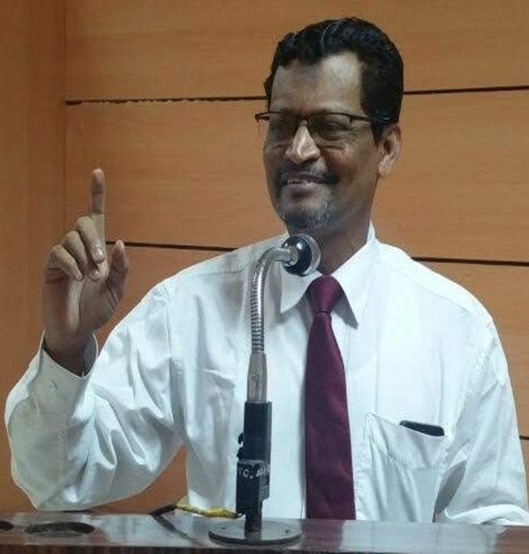
Who Am I?
Right Coach Khaleelullah M H
36 Years Experience in Sales & Training – Various Industries
A Corporate Leadership Coach, Career Coach & Memory Coach
Member of International Career Counsellors Club
Member of Career Counselling Foundation (London)
International Certified Career Coach from Mindler
Member of Counsellors Council of India
Certified Counsellor from 3G IRPS
Retired as National Head for Sales Capabilities – PepsiCo India
Having International Sales & Training Experience in UAE, Bangladesh & Bahrain

Slide 3
Further Studies
If you want to earn immediately after
your graduation
If you want to earn hefty salaries
New or lesser known courses / job opportunities

Slide 4
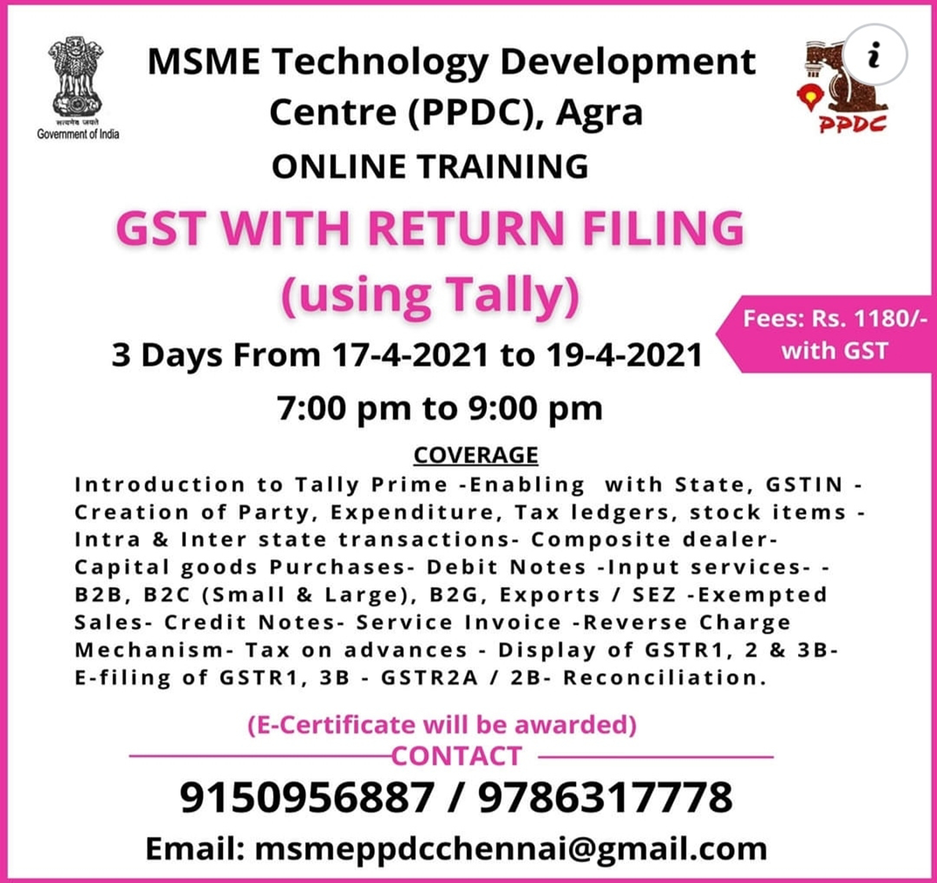
Want to EARN immediately?
IRDAI – IC 38
MSME courses
65, 1, Grand Southern Trunk Rd, opposite Road To balaji hospital, Guindy Industrial Estate, Poomagal Nagar, Guindy, Chennai, Tamil Nadu 600032

Slide 5
NISM – V A
1) NISM Mutual Fund Distributors Certification is a mandatory requirement for all people engaged in sales & distribution of Mutual funds.
2) Bank Employees & Financial Advisors who sell mutual funds have to pass this NISM Mutual Fund Distributors Exam.
3) Insurance Advisors who want to become MF Distributors should pass NISM VA Mutual Fund Exam.

Slide 6
LI GI HI
General insurance Council offers Diploma & Advanced Diploma in Life Insurance Underwriting jointly with Association of Insurance Underwriters (AIU)- 30 M policies issued
Certificate Course on Compliance, Governance and Risk Management in Insurance – 3 days class, online exam
III offers Certified Insurance Anti-Fraud Professional (CIAFP) Jointly with North American Training Group (NATG)
Professional:
Licentiate of Insurance Institute of India
Associate Member of Insurance Institute of India
Fellow Member of Insurance institute of India

Slide 7
Ins Inst Inida Courses
1. Specialized Diploma on Marine Insurance
2. Specialized Diploma on Fire Insurance
3. Specialized Diploma on Health Insurance
4. Certificate Program in Advanced Insurance Marketing (CPAIM)
5. Certificate Course in Foundations of Casualty Actuarial Science
6. Specialized Diploma in Casualty Actuarial Science
7. Diploma in Life Insurance Underwriting
8. Advance Diploma in Life Insurance Underwriting
9. Compliance, Governance and Risk Management in Insurance

Slide 8
NISM- 1 stop for career in securities Market
Post Graduate Certificate in Securities Markets (PGCSM) – partnered with ICICI Bank – 9 months CRT 3 months Internship at ICICI Bank. Fee ₹4 lacs-Loan from ICICI.
Placement with ICICI group with salary range of ₹12 L.
Post Graduate Program (Portfolio Management / Investment Advisory / Research Analysis) – 15 months Week ends – Mumbai
LL. M – Investment & Securities Law – 1 year
PGDM- Securities Market – 2 years – AICTE approved -CAT, XAT, CMAT, ATMA, MAT, GMAT or MH-CET (Management).
756 L, 9th Floor, Overseas Towers, Mount Road, Opp. TVS Honda Showroom, Anna Salai, Chennai, Tamil Nadu 600002
NSE / NCFM (Capital Marketd,Derivatives,MF – www.nsdl.co.in

Slide 9
(new) studies for hefty salaries
ACCA (the Association of Chartered Certified Accountants) is the global body for professional accountants.
An Actuary is a business professional who analyzes the financial consequences of risk.
Actuaries use mathematics, statistics, and financial theory to study uncertain future events, especially those of concern to insurance and pension programs.
IIFT -IB

Slide 10
Founded in 1904, the Association of Chartered Certified Accountants (ACCA) is the global professional accounting body offering the Chartered Certified Accountant qualification (ACCA).
ACCA's headquarters are in London with principal administrative office in Glasgow.
ACCA works through a network of over 104 offices and centres in 52 countries - with 323 Approved Learning Partners (ALP) and more than 7,300 Approved Employers worldwide, who provide employee development.

Slide 11
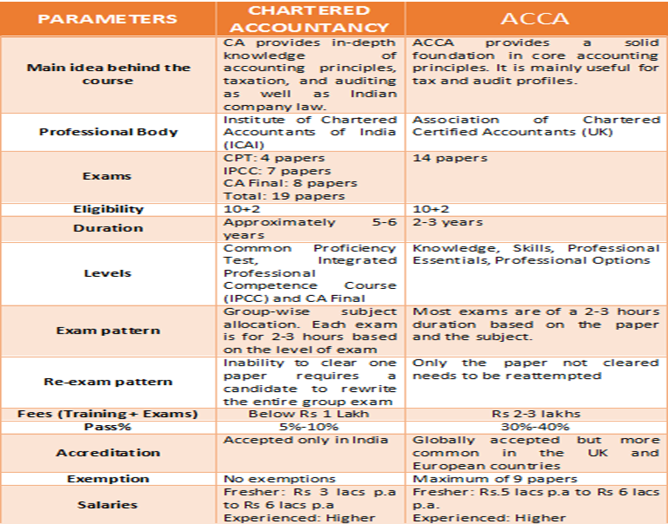

Slide 12
BIG 4

Slide 13
Actuary
http://www.actuariesindia.org/
Actuaries Make Financial Sense of the Future
Actuaries are experts in assessing the financial impact of tomorrows uncertain events. They enable financial decisions to be made with more confidence by: · Analyzing the past · Modelling the future · Assessing the risks involved, and · Communicating what the results mean in financial terms.

Slide 14
Actuary
Who can become an Actuary? • An HSC passed, graduate, post graduate, Engineer, MBA, CA, ICWA etc with sound knowledge in Mathematics & Statistics • Loves logic and problem solving • Good communicator • Excellent business awareness

Slide 15
Actuary
Actuaries in India can work in the following areas: Life Insurance
General Insurance
Health Insurance
Reinsurance Companies
Pension Funds
Consultants
Investments
Government
Academics
Risk Management

Slide 16
Indian institute of Foreign Trade – Delhi / Kolkata
MBA(IB): Full Time – International Offer ₹ 75 L; Domestic: ₹ 25 Lacs
MBA(IB): Weekend
Executive Programmes (On Campus)
Executive Programmes (Hybrid/ Off Campus)
MA (Economics)
Certificate Programmes : CPEM | CPCFM | CPGTLO

Slide 17
SSC
Asst Audit Officer – ₹48k - ₹150k
Asst Section officer - ₹45k -₹140k – Central Secretariat, IB, Rlys, External Affairs
Asst Section officer -₹35k – 112 k – Other Ministries
Inspector – Central Excise & IT
Asst Enforcement Officer – Revenue Dept
Jt Statistical Officer, Auditor, Accounts
Notes:
https://www.youtube.com/watch?v=b8fGcvM0v98
https://www.youtube.com/watch?v=bG2AvUXnWYU
https://www.youtube.com/watch?v=ku8FTLkdAis
https://www.adda247.com/jobs/ssc-cgl
https://www.youtube.com/watch?v=W4Nivcv1g2I

Slide 18
UPSC, TNPSC
IES Indian Economic Service ICAS: Indian Civil Accounts Service
ISS : Indian Statistical Service IAAS: Indian Audit & Accts Service
IDAS: Indian Defense Accounts Service ISS: Indian Statistical Service
IESE: Indian Economic Services
TNPSC
Assistant Commissioner in the Tamilnadu Hindu religious & charitable endowments administration department
Asst. Director included in Tamilnadu employment and training service
Assistant Director of Handloom and Textiles
Assistant Commissioner Commercial Taxes
Deputy Registrar of Co-operative Services
Assistant Director of Rural Development
District Fire Officer

Slide 19
Foreign language
Learning foreign language can add brownie points to your CV.
Additionally, it will help you to improve your vocabulary and interacting skills.
With online courses on offer, learning any foreign language of your choice is no more a distant dream.
Foreign language can also help you to bag the job of a translator.
Korean, Japanese, Chinese

Slide 20
Foreign Language
1. Korean Classes at Inko Centre- InKo Centre, No: 18, Adyar Club Gate Road, Chennai. Phone: 044 – 26361224.
2. German at Goethe-Institut (Max Mueller Bhavan)- No.4 (Old No.14), 5th Street, Rutland Gate, Chennai. 044 – 2833 1314. Email: info@chennai.goethe.org
3. Communiqua Foreign Language Institute- Apart from French, Communiqua offers courses in Spanish, German, Chinese, Japanese, and Korean.
66-A, Purasaiwalkam High Road, Purasaiwalkam, Chennai. Phone: 044 – 26416799. Email: communiqua@gmail.com
Notes:
https://www.studyfrenchspanish.com/language-courses-chennai/

